Slide 1
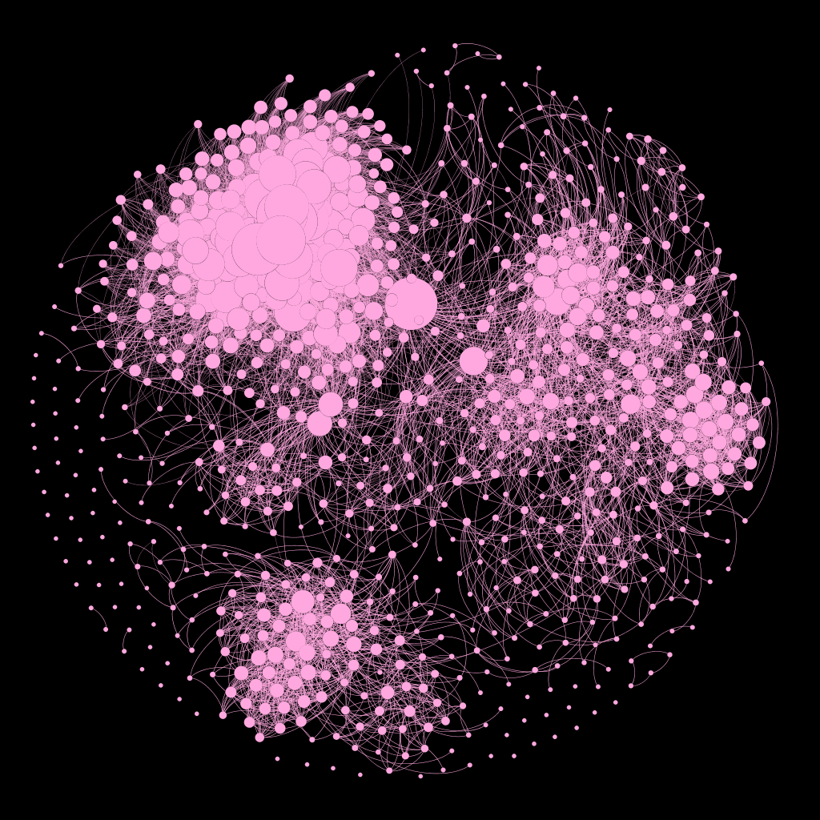
the mathematics of revolution

Slide 2
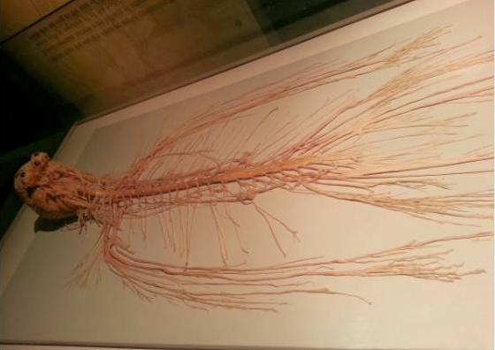
Q. what makes us human?

Slide 3
UNIQUE CORRECT ANSWER

Slide 4
A. agency and our relations

Slide 5
agent-based models
+
=
social networks
complex social behaviour

Slide 6
agent-based models

Slide 7
talking about fish so we can talk about birds so we can talk about humans

Slide 8
fish

Slide 9
starlings

Slide 10
economic inequality

Slide 11
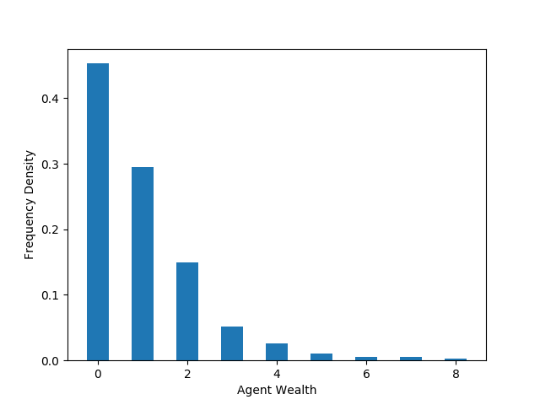

Slide 12
more money solves everything?

Slide 13
Naaaa

Slide 14
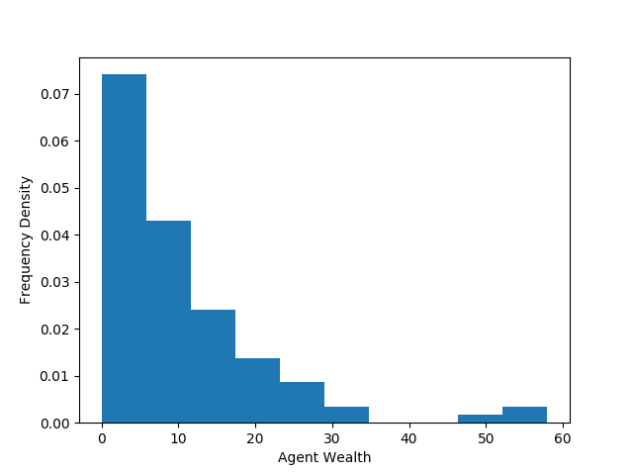

Slide 15
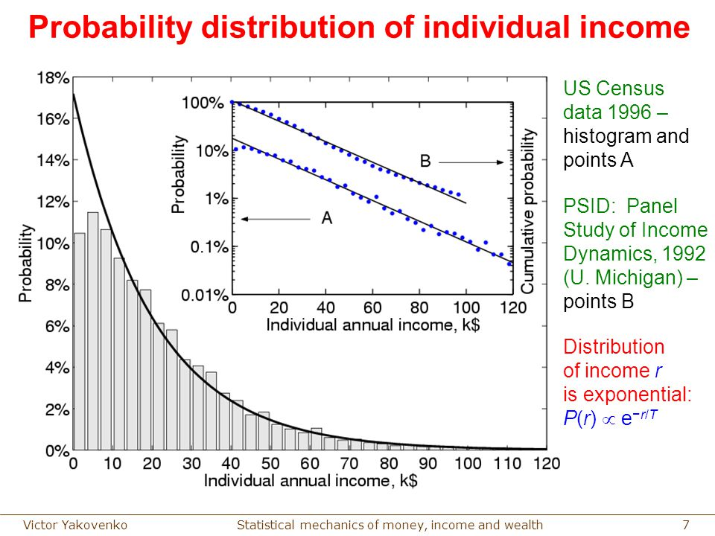

Slide 16
social networks

Slide 17
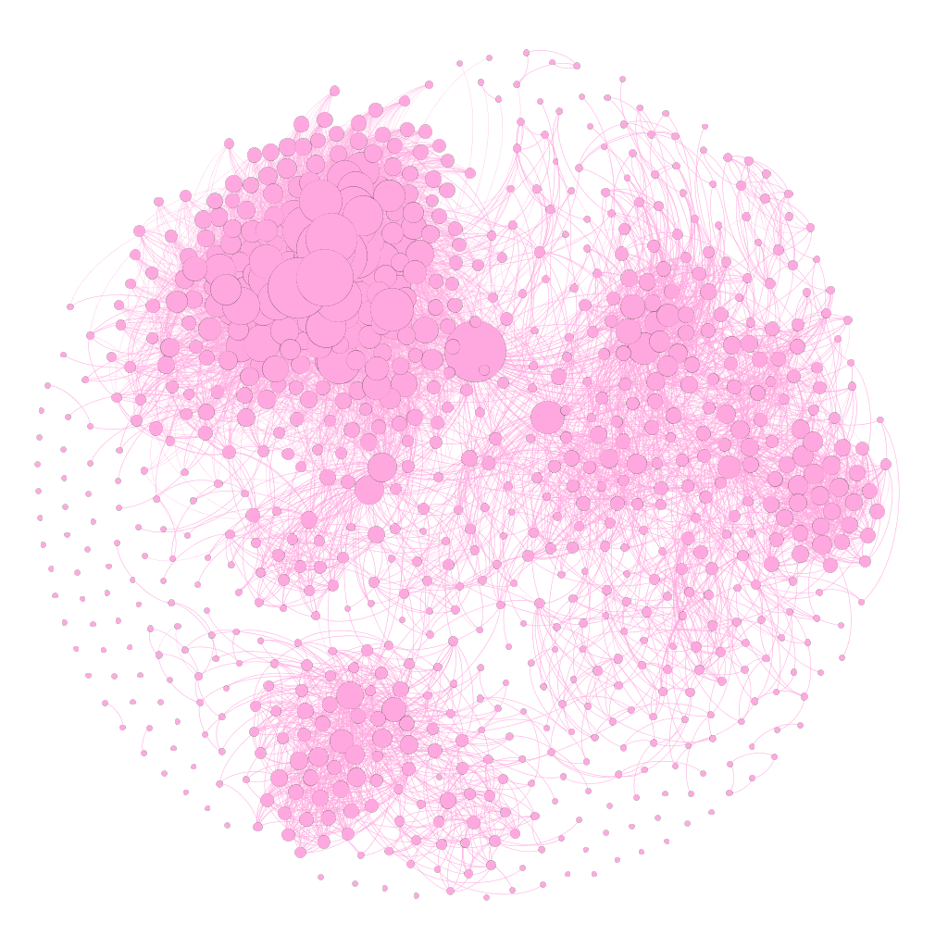

Slide 18
Reasons to not be friends with a mathematician (a non-exhaustive list)

Slide 19
1)-99) left as proof to the reader
100) they make visualisations like this:

Slide 20
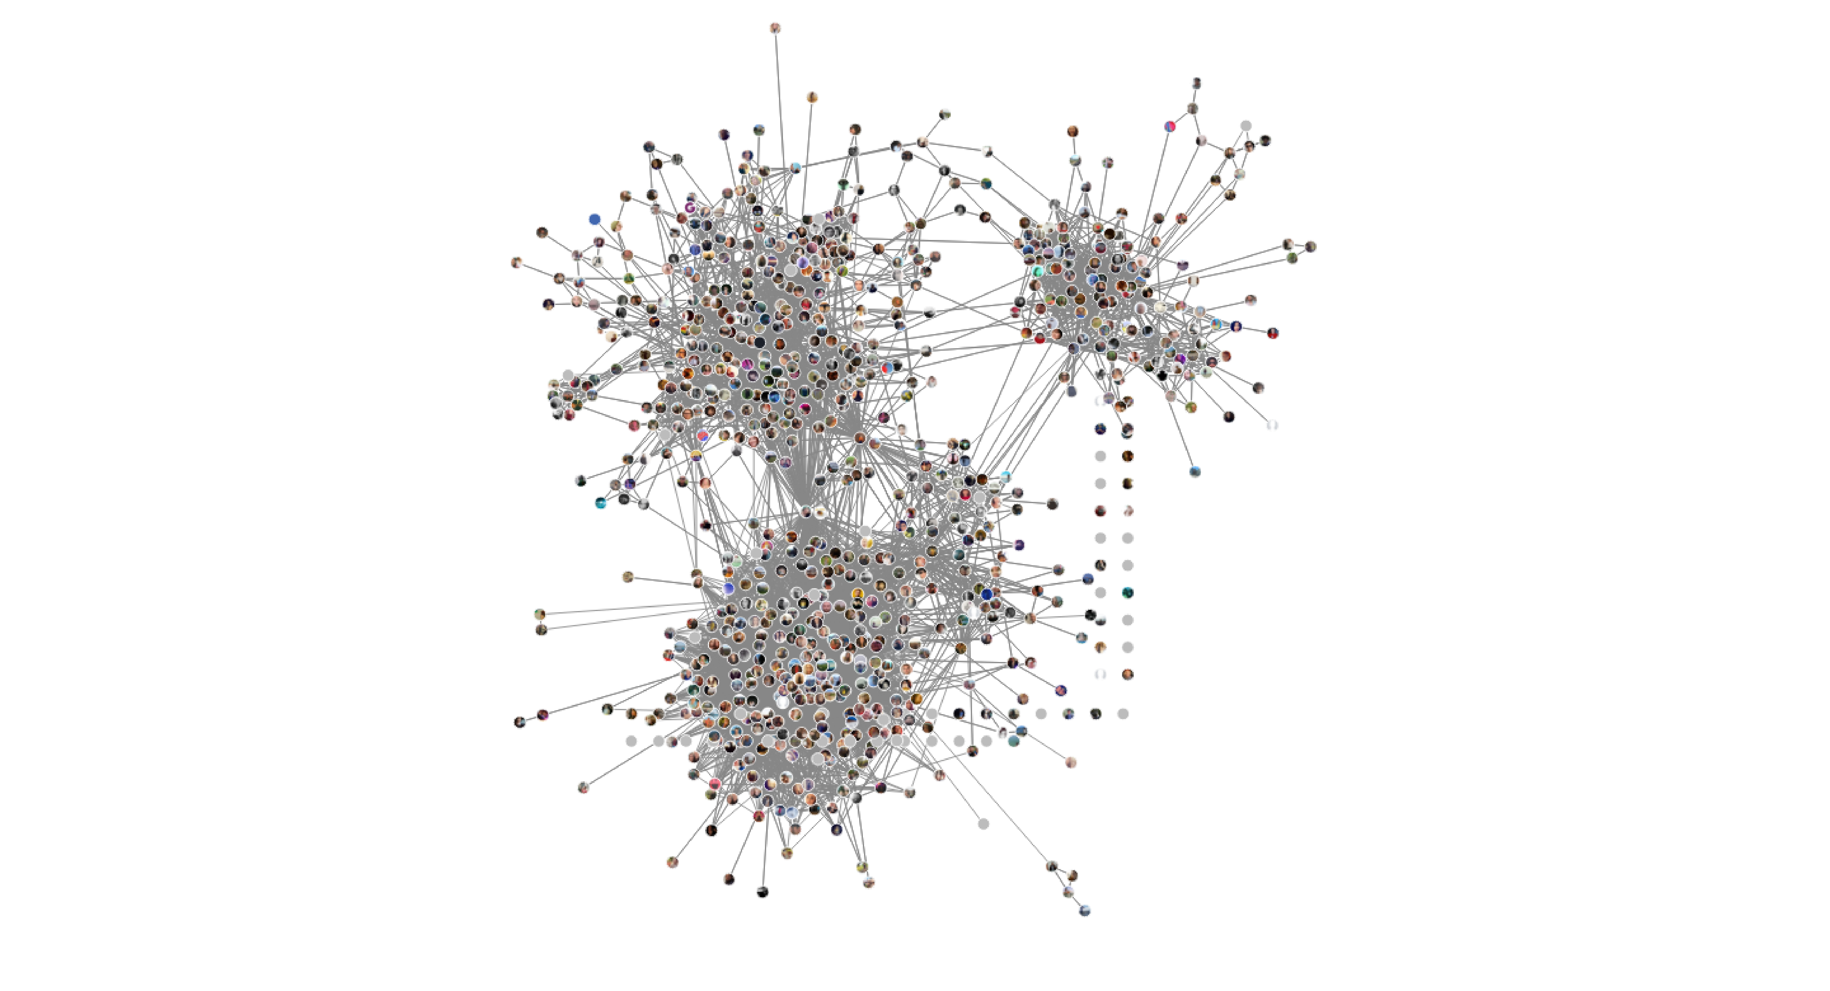

Slide 21
101) and make spreadsheets like this:

Slide 22
what should we look for?

Slide 23
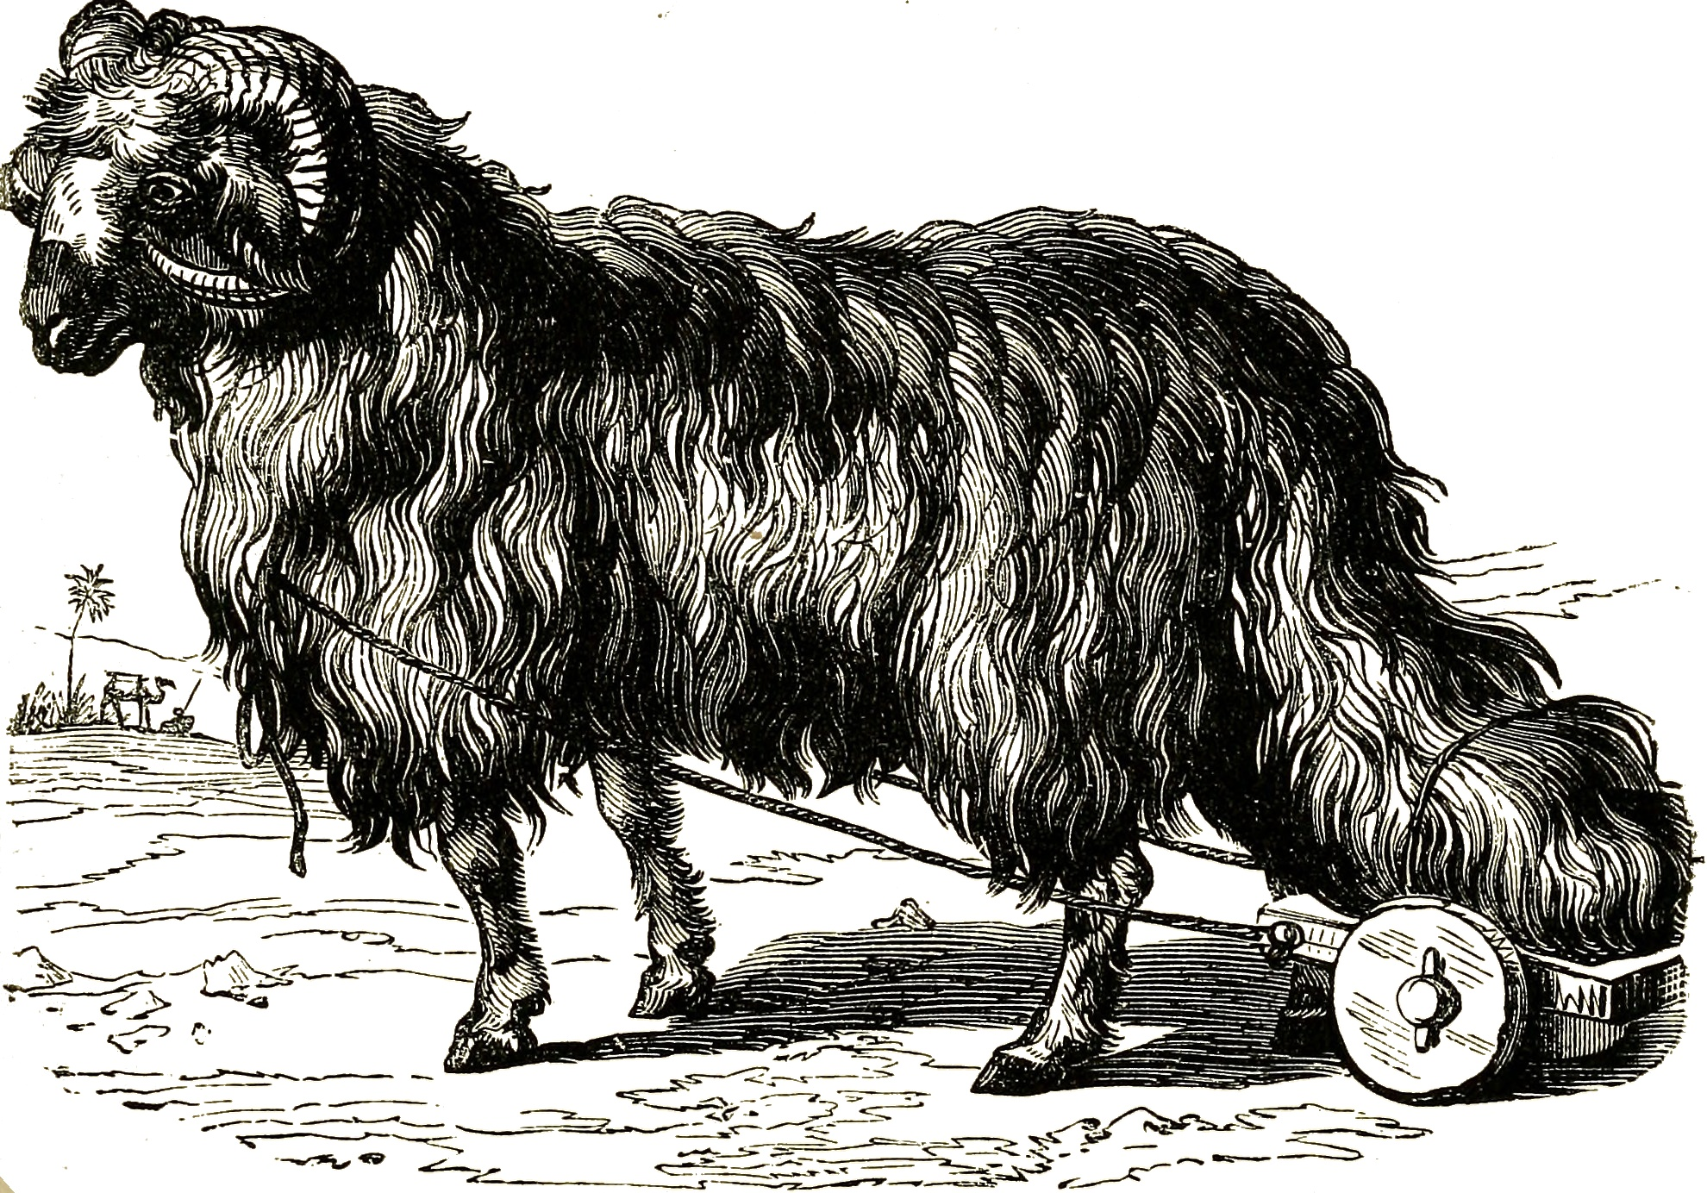

Slide 24
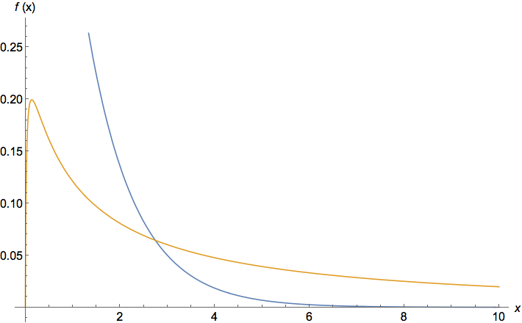
heavy tails

Slide 25
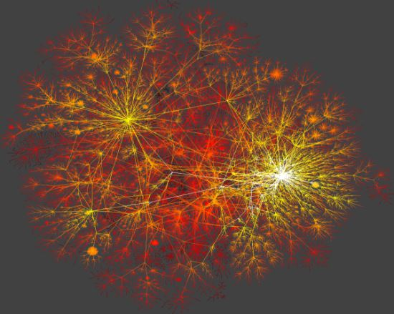

Slide 26
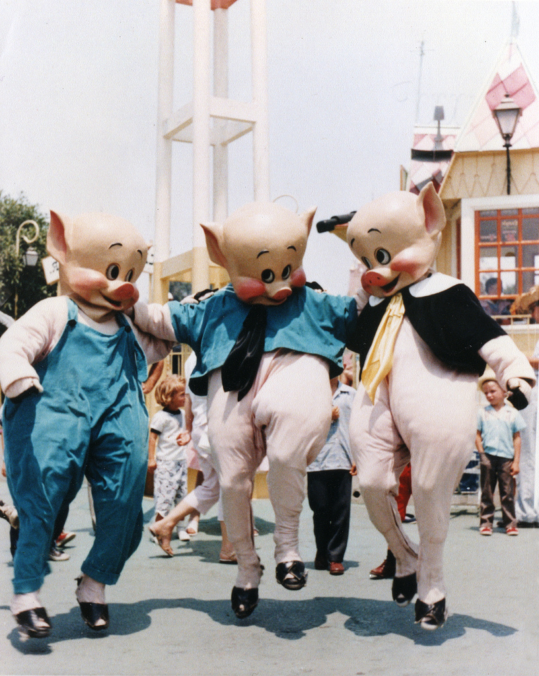
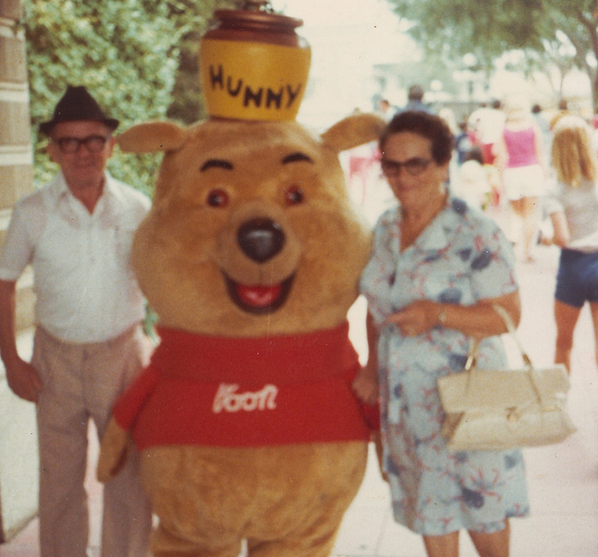

Slide 27
small world

Slide 28
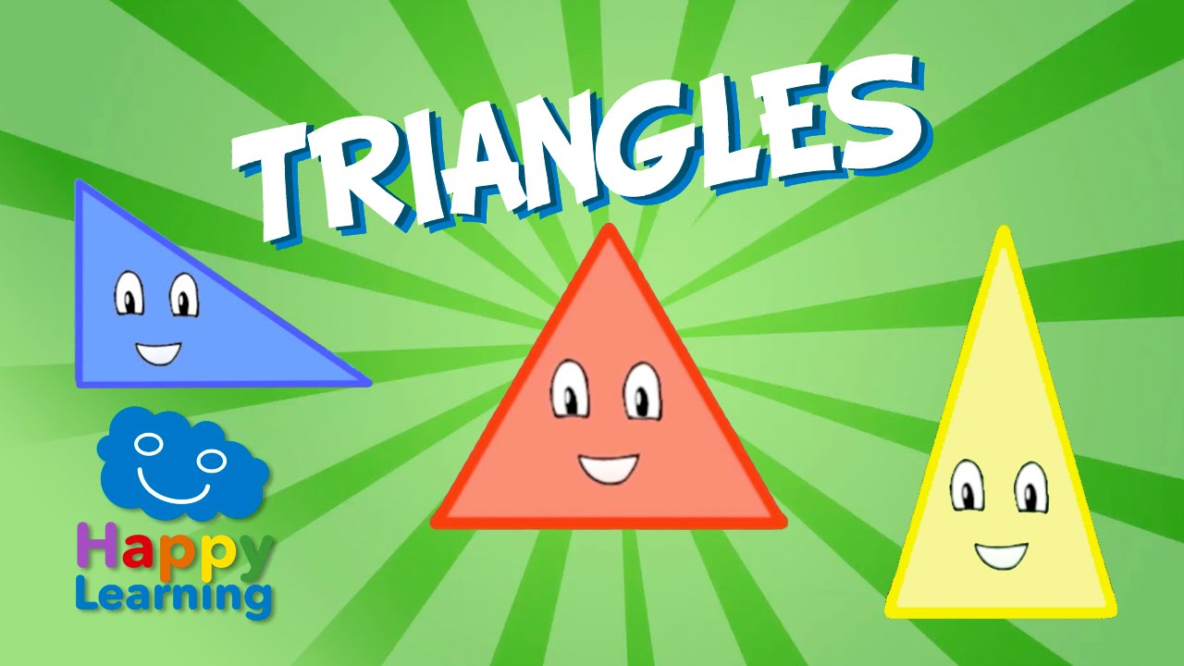

Slide 29
Every triangle is a love triangle when you love triangles

Slide 30
triadic closure

Slide 31
barábasi-albert model

Slide 32
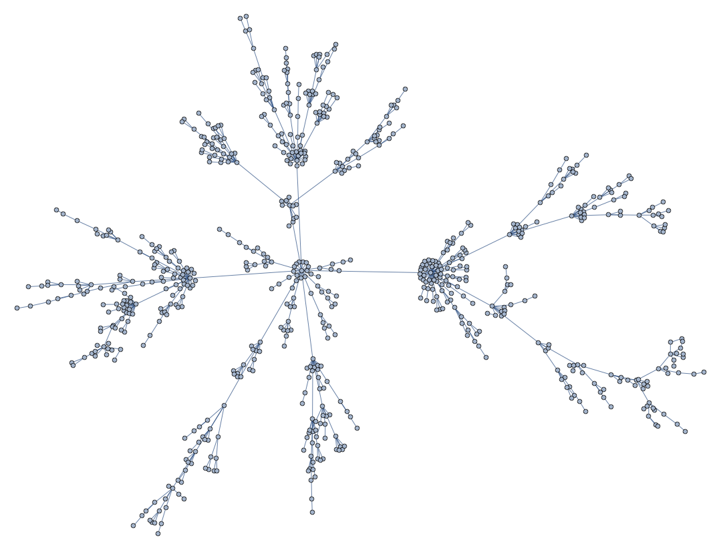

Slide 33
watts-strogatz model

Slide 34
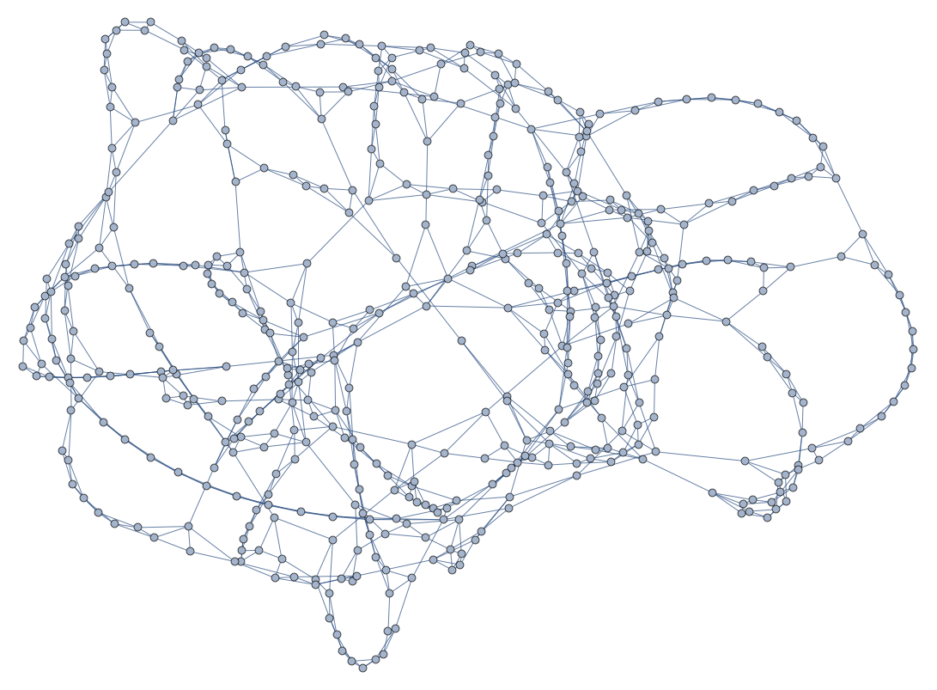

Slide 35
economic inequality on a network

Slide 36
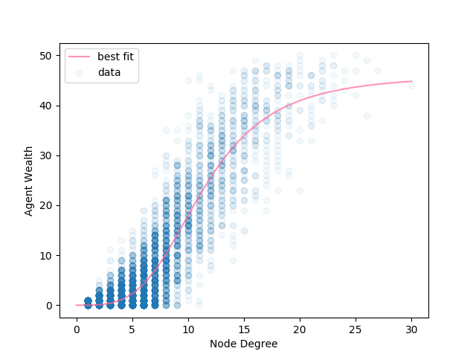

Slide 37
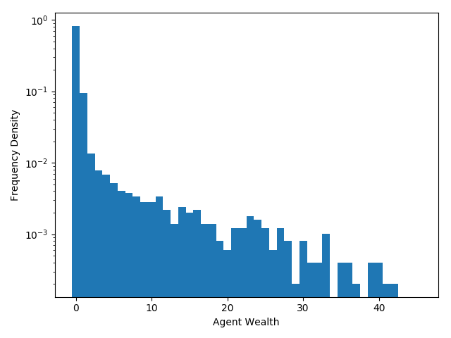

Slide 38
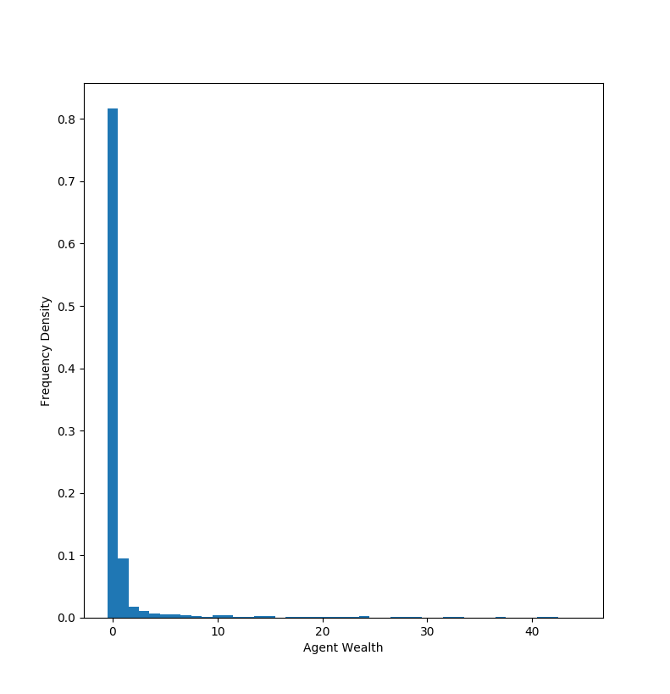

Slide 39
models of revolution

Slide 40
epstein’s model of civil violence

Slide 41
non-violence

Slide 42
3.5%

Slide 43
my model

Slide 44

inspired by illness

Slide 45
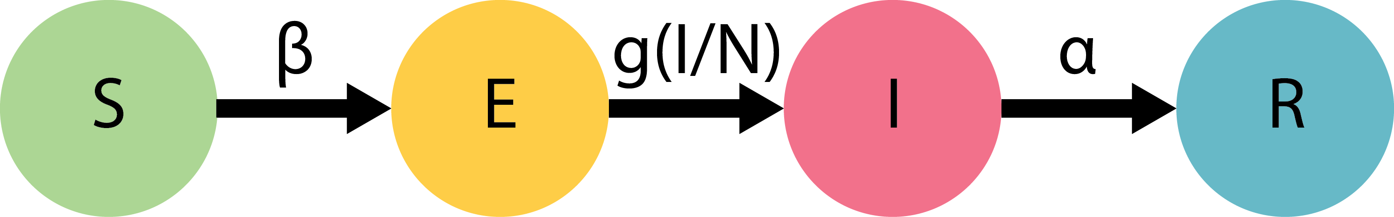

Slide 46
believing an idea vs. acting on it

Slide 47
social influence

Slide 48
Thank God for the Zealots!

Slide 49
Revolutionary threshold

Slide 50
let’s play in the sandpit

Slide 51
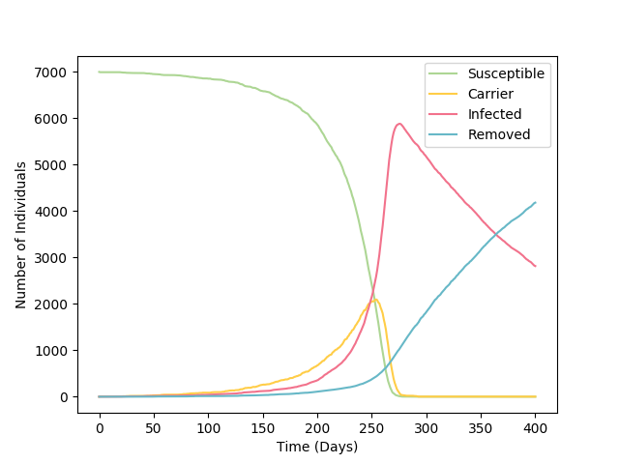

Slide 52
clustering and spread

Slide 53
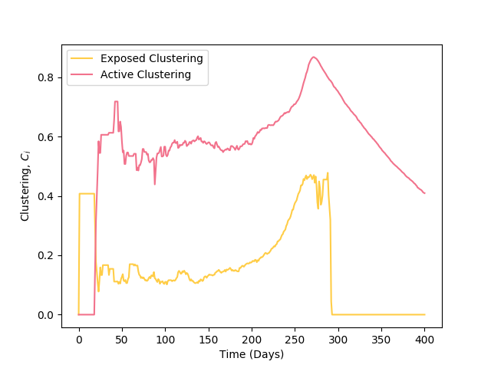
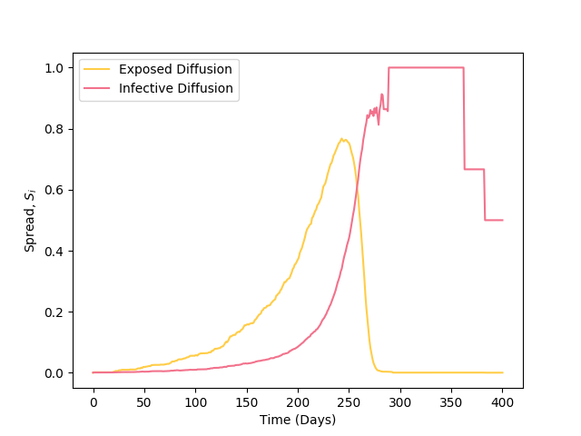

Slide 54
lessons for revolutionaries

Slide 55
that’s revolting

Slide 56
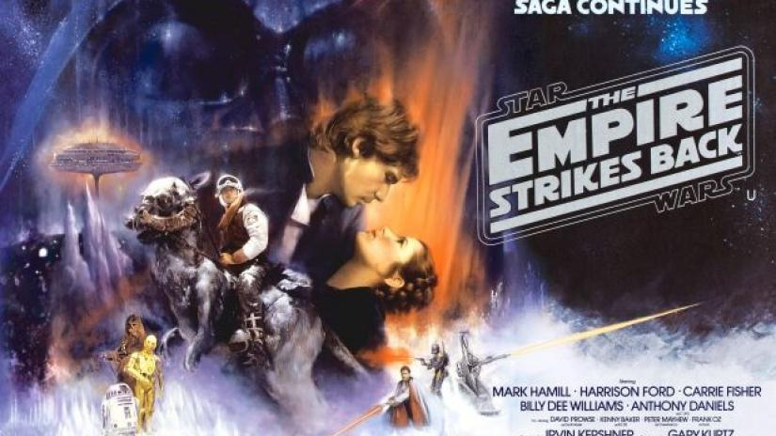

Slide 57
jobs for the next person

Slide 58
thanks

Slide 59
all the code is open-source and accessible at github.com/joekroese/

Slide 60
questions?

Slide 61
